Slide 1


Resources to train GIT

Slide 2


Git resources
Git Handbook: https://guides.github.com/introduction/git-handbook/

Slide 3
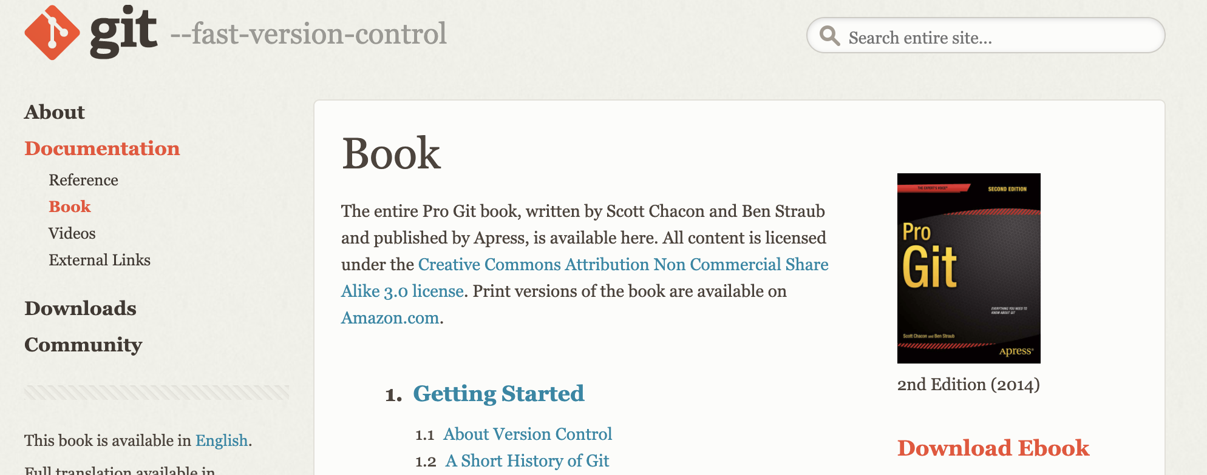
Git resources
Git Pro Book: https://git-scm.com/book/en/v2

Slide 4
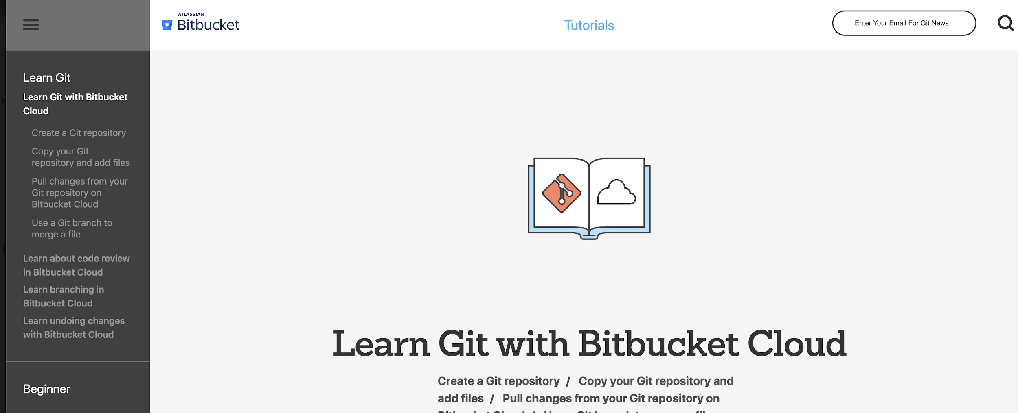
Git resources
Attlasian: https://www.atlassian.com/git/tutorials/learn-git-with-bitbucket-cloud

Slide 5
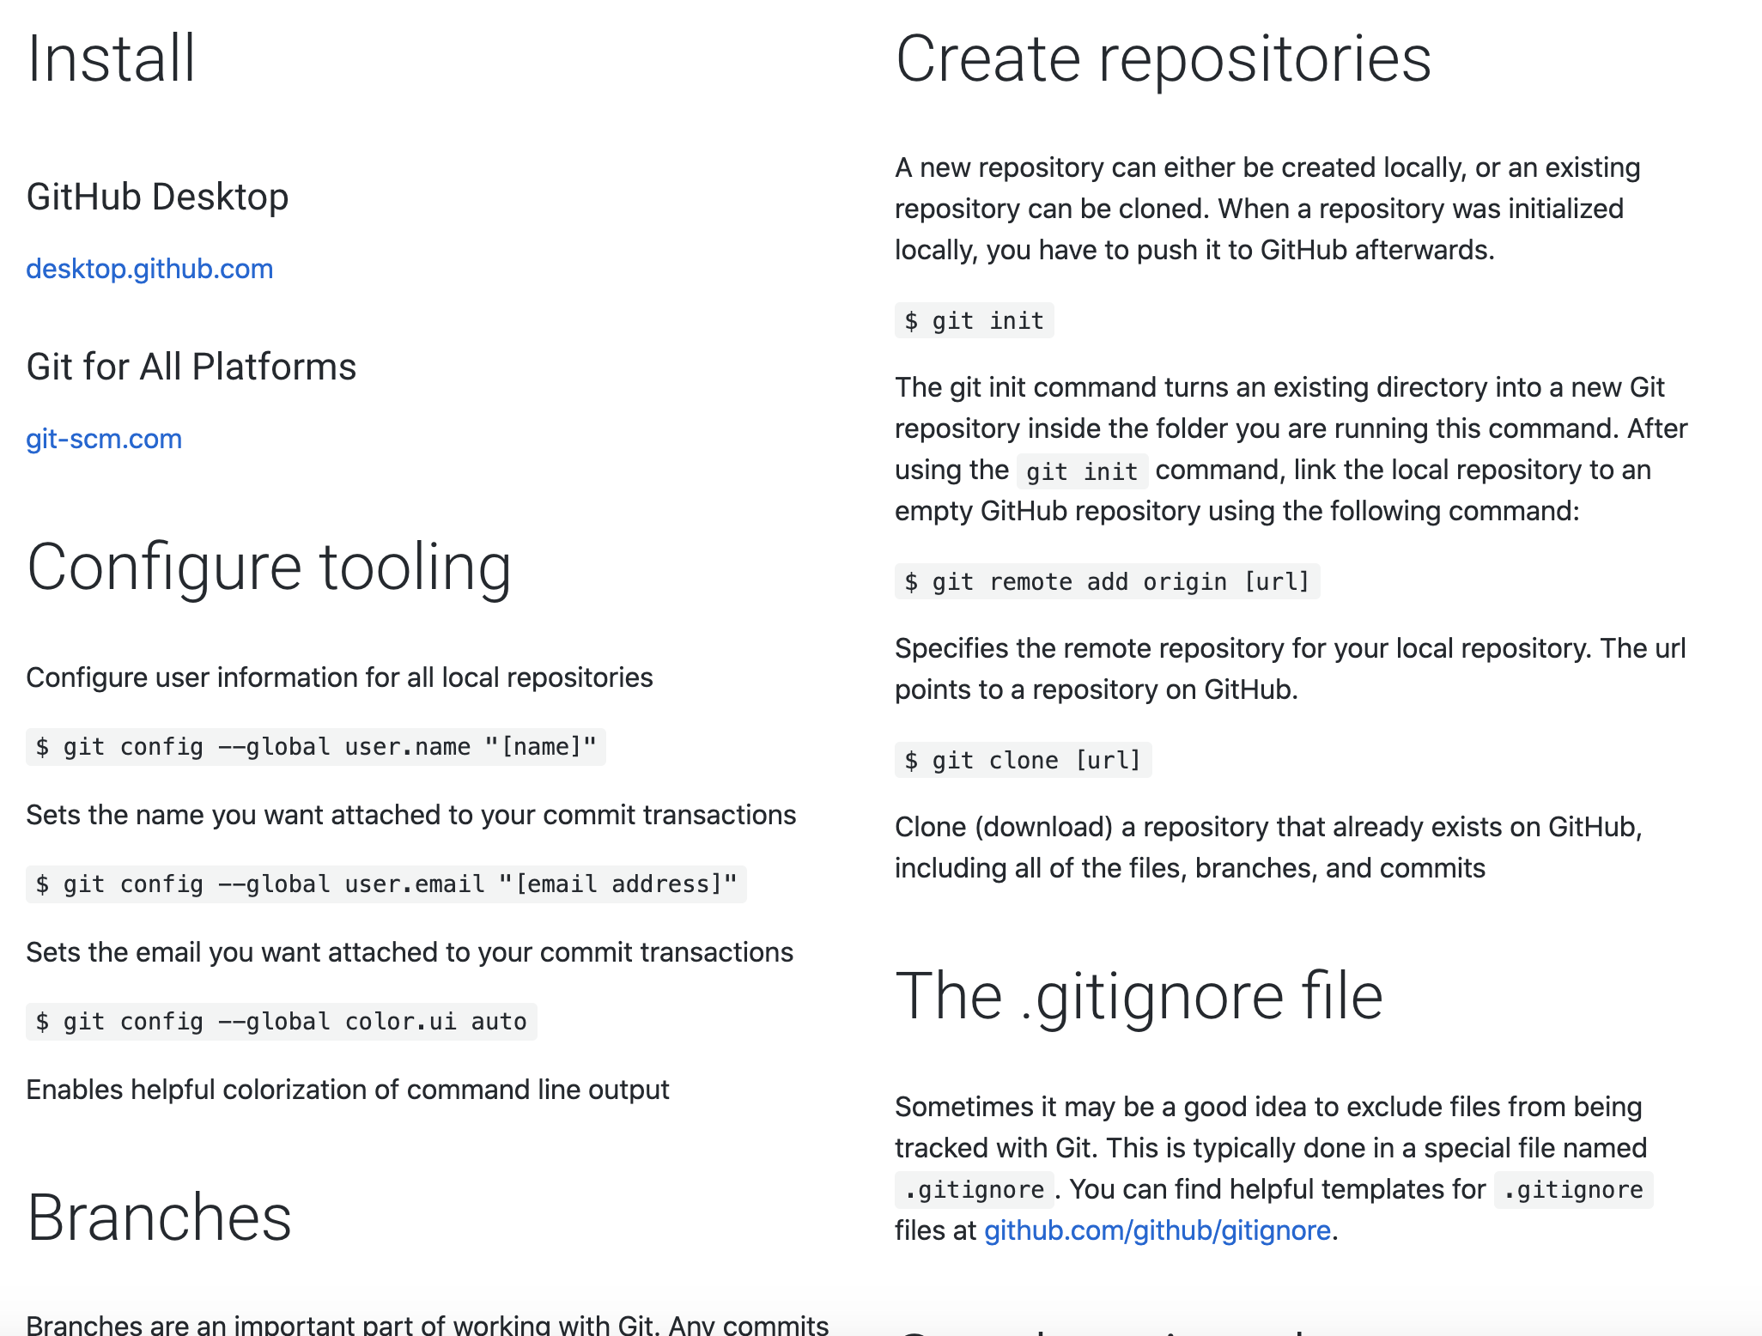
Git resources
Git CheatSheet: https://training.github.com/downloads/github-git-cheat-sheet/

Slide 6
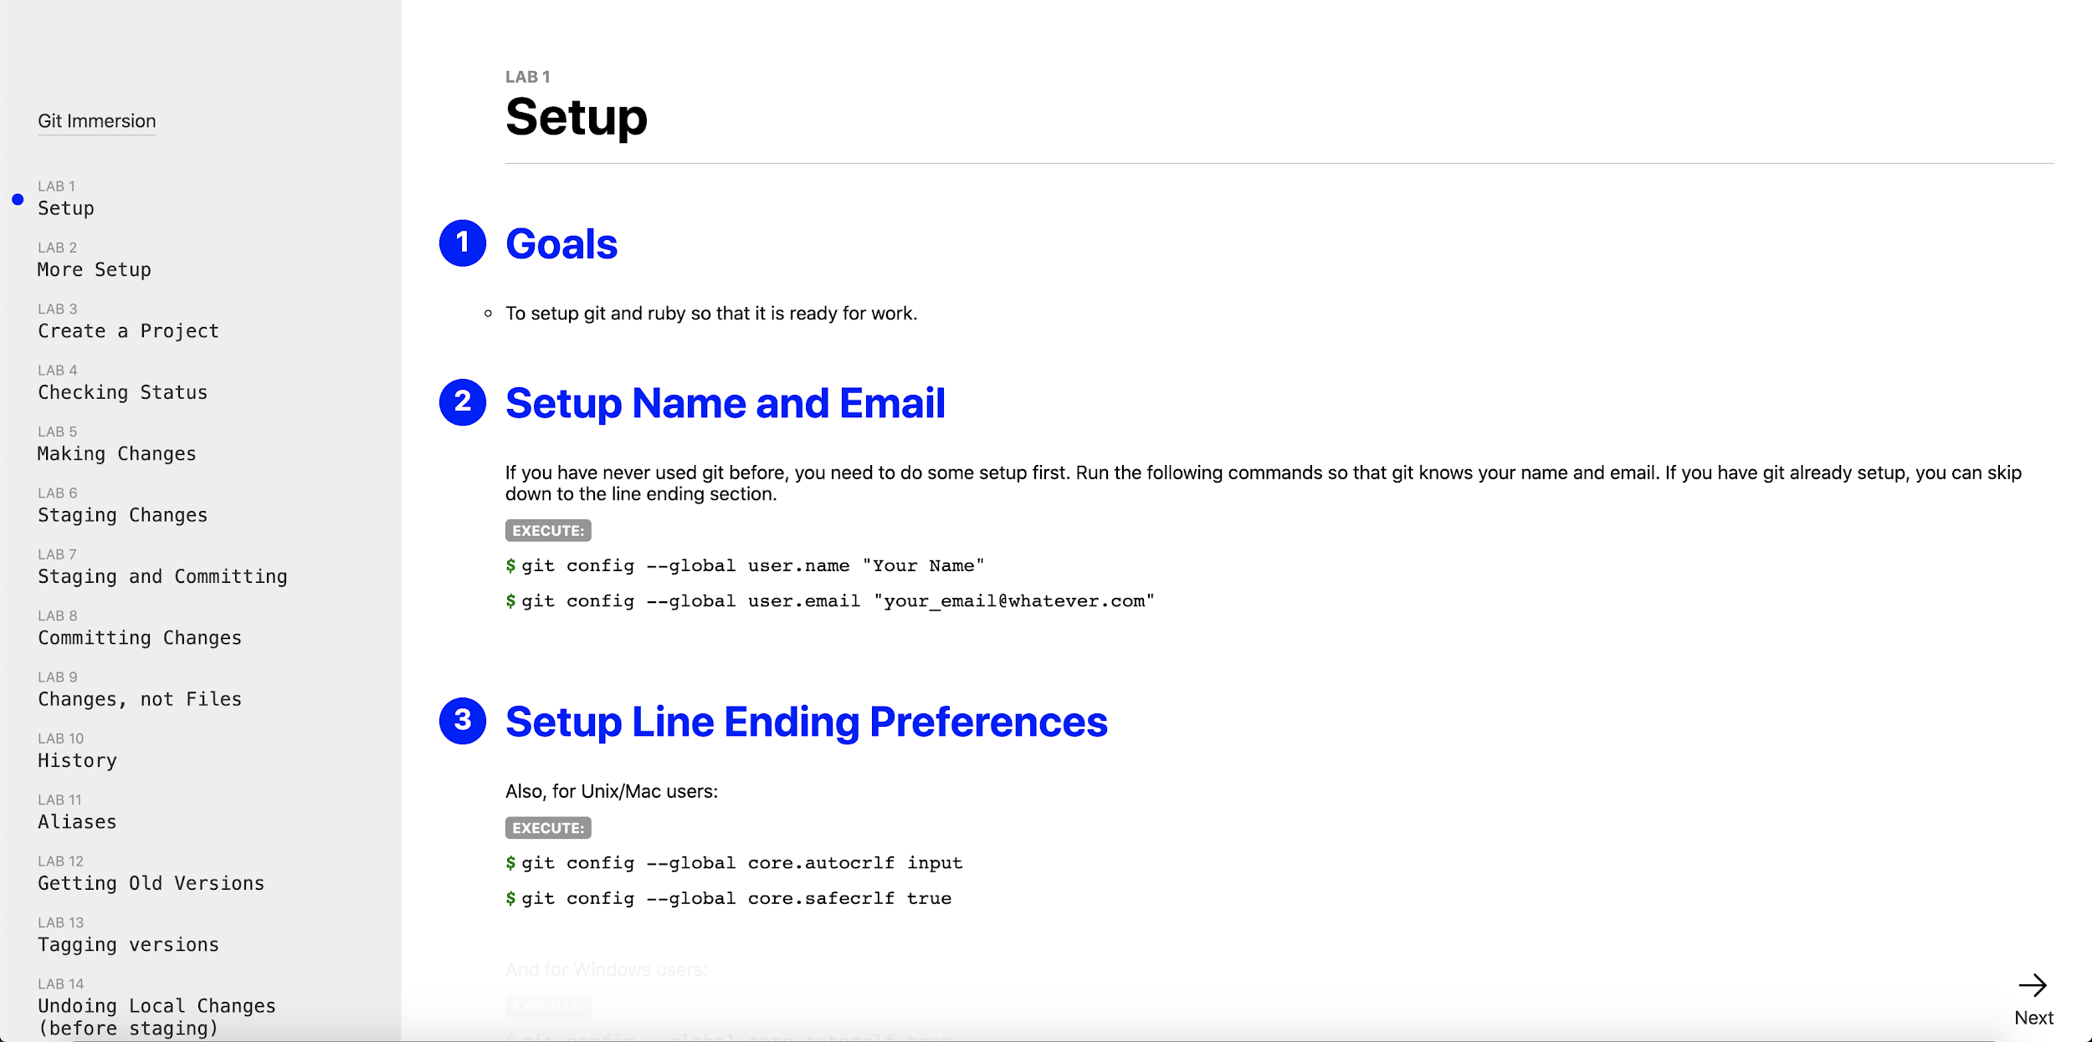
Practice
Git Immersion: https://gitimmersion.com/

Slide 7
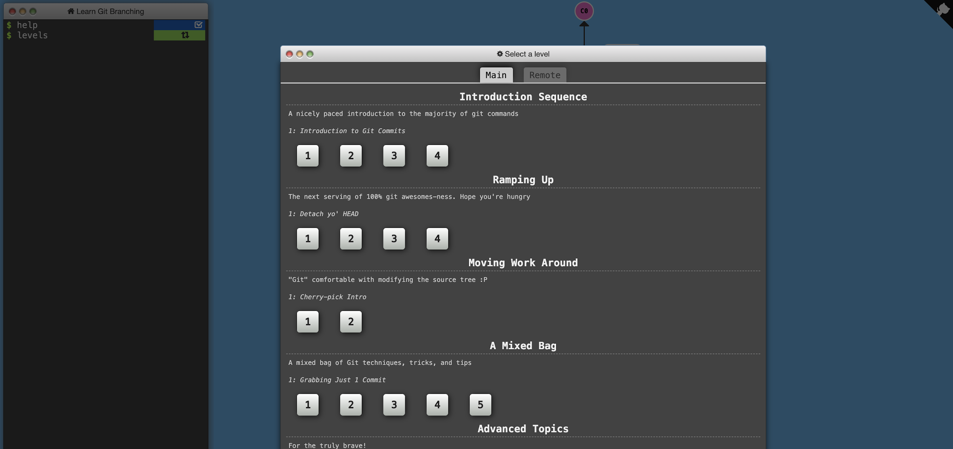
Practice
Learn Git Branching: https://learngitbranching.js.org/

Slide 8
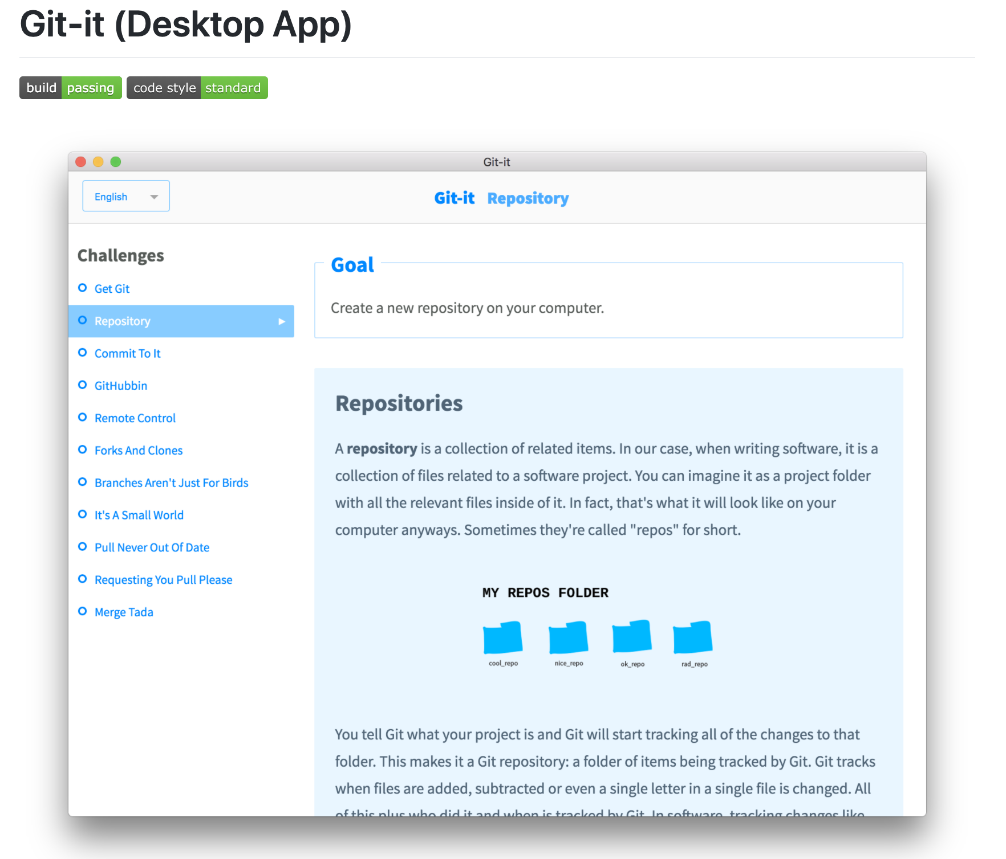
Practice
Git it: https://github.com/jlord/git-it-electron#what-to-install

